Slide 1
Scraping Data the Right Way
November 9, 2022
Notes:
Welcome. We are so happy you’re here.

Slide 2
Research the Right Way
A series of workshops on applied problems in data collection and manipulation
Share our knowledge, best practices for those problems
Prepare you for stricter Open Science requirements

Slide 3
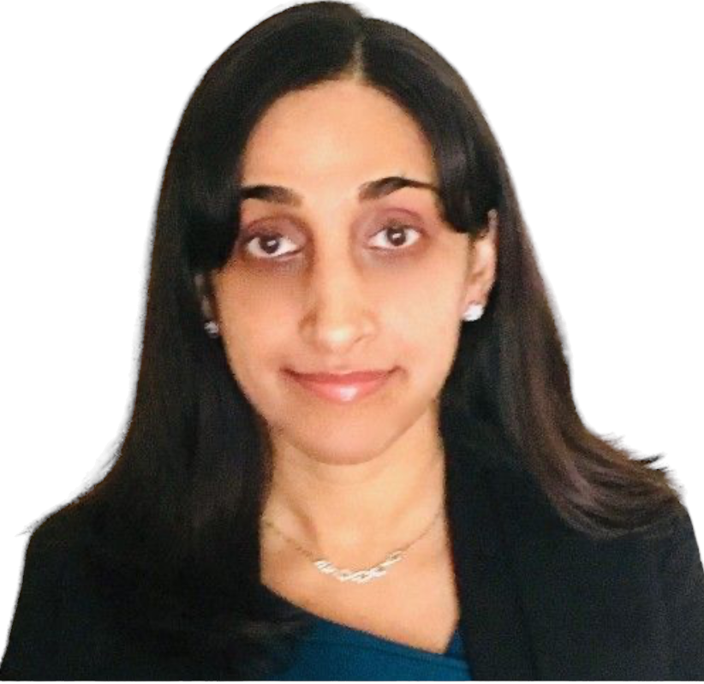
Goals for Today's Session
Help you to write more effective scraping code
GET methods (requests, wget, curl) for fetching
Parsing results (BeautifulSoup)
Applying principles for replicability
How and why to automate a browser (Selenium)
Understand risks of collecting data by scraping
Ambreen Chaudhri
Senior Computational Research Consultant

Slide 4
Principles for Research Replicability
Automate wherever possible.
Embrace code abstraction to break programming tasks into discrete pieces.
Maintain good records, including version control and self-documenting code.
Test your code and results relentlessly.

Slide 5
Scraping = Harvesting + Parsing
Harvesting - Saves page contents (usually HTML) returned by a call to a website.
Parsing - Identifies and saves specific data elements of interest from a page.

Slide 6
Scraping Mechanics

Slide 7
To Follow on KLC
Open a GNOME Terminal Session in FastX
(or ssh to KLC with graphics enabled.)
To clone the github repo:
git clone https://github.com/rs-kellogg/Research_the_Right_Way
To access the code and run the notebook:
cd ~/Research_the_Right_Way/scraping
module load python/anaconda3.6
module load chrome/72
conda create -n scraping_env python=3.6
﻿source activate scraping_env
jupyter notebook --browser=chrome

Slide 8
Web Scraping Done Right
Write progress logs that make restarts easier.
Build delays and kill-switches into the harvesting step.
Test anything that could go wrong.
Write progress logs that make restarts easier.
Separate harvesting from parsing... but not by too much.
Use Selenium and Beautiful Soup for different things.
Assume website layouts will change over time.

Slide 9
Risks of Gathering Web Data

Slide 10
Risks of Scraping Research Datasets
Will I be able to gather all the data that I need?
Will I be able to publish results in my preferred journal?

Slide 11
Can I gather data? Examine robots.txt
Most sites have a robots.txt file, which gives you clues as to what the site will (or will not) tolerate.
https://www.justice.gov/robots.txt​
User-agent: *​ Crawl-delay: 10​ # Directories​ Disallow: /includes/​ Disallow: /misc/​ Disallow: /modules/​ Disallow: /profiles/​ Disallow: /scripts/​ Disallow: /themes/​ ​ # Paths (no clean URLs)​ Disallow: /?q=admin/​ Disallow: /?q=comment/reply/​ Disallow: /?q=filter/tips/​ Disallow: /?q=node/add/​ Disallow: /?q=search/
Risks of ignoring the robots.txt:
Block incoming traffic from your IP
CAPTCHAs
Garbage results

Slide 12
May I scrape data? Know Terms of Service
Most sites also come with an "end user agreement" or "terms of service."
Violations may result in account suspension, legal penalties against you and/or Northwestern (if you use Northwestern's network.)
https://www.linkedin.com/legal/user-agreement#dos
You agree that you will not:
Create a false identity on LinkedIn, misrepresent your identity, create a Member profile for anyone other than yourself (a real person), or use or attempt to use another’s account;
Develop, support or use software, devices, scripts, robots or any other means or processes (including crawlers, browser plugins and add-ons or any other technology) to scrape the Services or otherwise copy profiles and other data from the Services;
Override any security feature or bypass or circumvent any access controls or use limits of the Service (such as caps on keyword searches or profile views);
Copy, use, disclose or distribute any information obtained from the Services, whether directly or through third parties (such as search engines), without the consent of LinkedIn;

Slide 13
May I scrape data? Know Terms of Service
Even sites that exist to share free information have similar restrictions!
https://www.topcoder.com/policy/terms-and-conditions
We hereby give you permission to download and print materials from this Website for the sole purposes of viewing, reading, and retaining for reference the materials for non-commercial use.
Any other copying, distribution, retransmission, or modification of information or materials on this Website, whether in electronic or other form, without our express prior written permission is strictly prohibited.
https://paperswithcode.com/site/terms
For example, and without limitation, you may not:
impersonate any person or entity or otherwise misrepresent your affiliation or the origin of any information or materials you submit;
engage in unauthorized spidering, “scraping,” or harvesting of content or information, or use any other unauthorized automated means to compile information from the Website;

Slide 14
Will I Be Able To Publish The Results?
Gathering data from a website is only one step in the research process.
Many journals have adopted more restrictive data provenance policies.
Such journals expect YOU to submit evidence that your use of third-party data – even publicly available data – is covered by an appropriate license.

Slide 15
More Web Scraping Done Right
Use robots.txt as signals of boundaries sites will enforce.
Save data use documents in addition to code & data.
Anticipate stricter editorial policies for Open Science.

